Slide 1
A day in the life of JN Data CDC

Slide 2
Intro to this session
Today you are going to be put in the shoes of JN Data CDC…
You will learn how to:-
Utilize the RE&CT framework
Utilize VERIS framework
Combine both to solve an Incident
How will we do this?
Each recruit has a A3 copy of RE&CT

Slide 3
A little about Martin

Slide 4

A little about David
British but slowly and surely becoming a dane!
Lived in Denmark 6 years with my wife, we now also have 2 kids and a house!
Cyber Defence Center Department Manager at JN Data
I love open source, the tools, the mindset the whole thing...
I run my own blog with a few friends, Security Distractions…

Slide 5

RE&CT Framework
Created by the awesome guys at Atomic Threat Coverage
Similar to the MITRE ATT&CK Framework
Incident Response contains repeatable actions
Document them
Heatmap them
Find gaps and improve

Slide 6
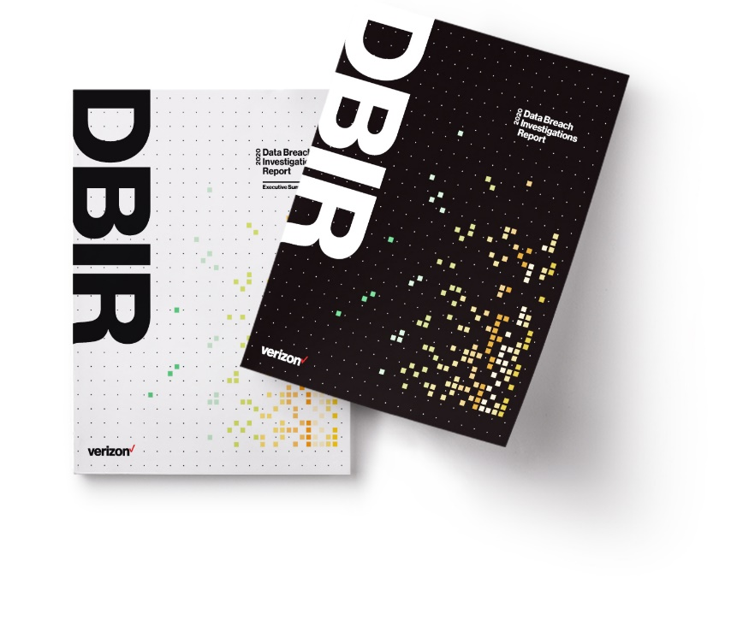
VERIS
VERIS or Vocabulary for Event Recording and Incident Sharing
A common language for how we can describe incidents
Enables powerful metrics by enforcing structure
Created by VERIZON
Utilized in the VERIZON DBIR
Based on the 4 A’s
Asset
Action
Actor
Attributes

Slide 7

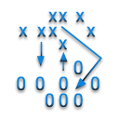







Qbot Case
1drv.com/11121212
Evilcorp.dk
Qbot Payload
Operating Agreement.vbs
Operating Agreement.zip

Slide 8
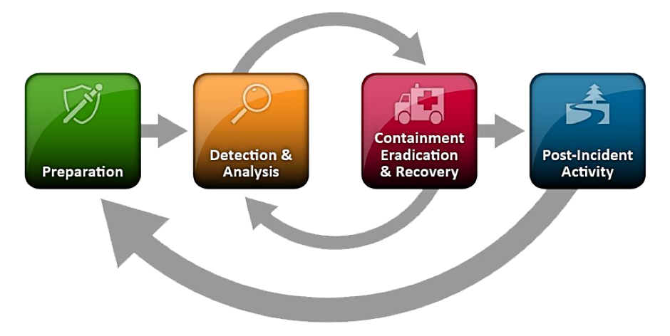
Incident Response Process

Slide 9
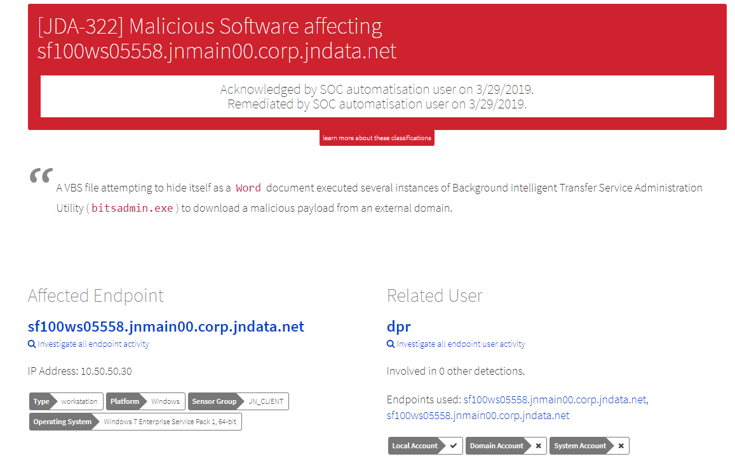
Detection

Slide 10
Analysis
VERIS Card
Incident_ID | 101
Security_incident | ?
Discovery_method | Alert
Action | ?
Asset.User(s) | DPR
Asset.Workstation(s) | sf100ws0558
Actor | ?
Attribute.Integrity | ?
Attribute.Confidentiality | ?
Attribute.Availability | ?
We can take the information contained within the alert and put it into a ready made VERIS card.
Our goal is then to populate the card throughout the incident response case

Slide 11
Analysis
When it comes to Incident Response analysis, we need to define some questions that need answering…
Has there been impact?
How many users have been hit?
Was the payload successfully retrieved?

Slide 12
How many users have been hit?
Which actions would you take to understand this?
Focus on the artifacts in the case
Email
Files
Collect the artifacts
Analyze the artifacts

Slide 13
Stage 3 – Analysis Card
ioc.name | ioc.type | ioc.notes | ioc.connected_with
? | email |  | dpr
evilcorp.dk | fqdn |  | sf100ws0558
Operating Agreement.vbs.doc | file |  | sf100ws0558
? | hash.md5 |  | sf100ws0558
? | file |  | sf100ws0558
? | hash.md5 |  | sf100ws0558

Slide 14
Email
Collect email message
List users opened email message
Can we use this to know if any other users were hit?
Extract observables from email message
One drive link
Follow the link, retrieve file etc

Slide 15
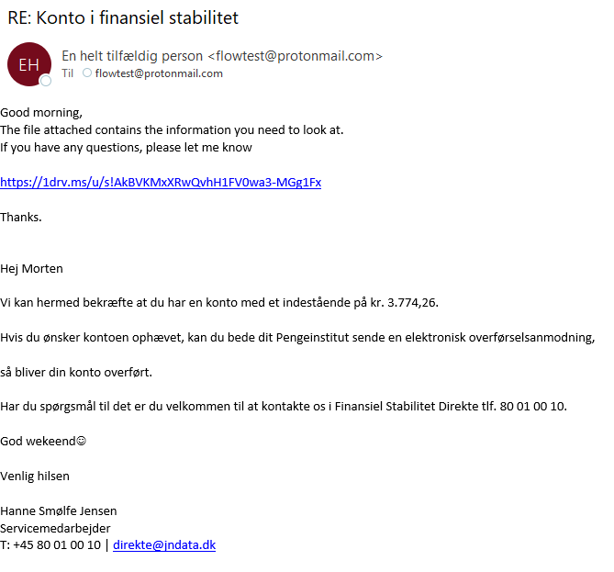

Slide 16
Stage 3 – Analysis Card
ioc.name | ioc.type | ioc.notes | ioc.seen_on
RE: Konto i finansiel stabilitet | email | Email contained onedrive link | sf100ws0558
evilcorp.dk | fqdn |  | sf100ws0558
Operating Agreement.vbs.doc | file |  | sf100ws0558
? | hash.md5 |  | sf100ws0558
? | file |  | sf100ws0558
? | hash.md5 |  | sf100ws0558

Slide 17
Files
Find file by path
Collect file
Analyse script
After collecting the vbs.doc file it was found to come from a .zip file.

Slide 18
Stage 3 – Analysis Card
ioc.name | ioc.type | ioc.notes | ioc.seen_on
RE: Konto i finansiel stabilitet | email | Email contained onedrive link | sf100ws0558
evilcorp.dk | fqdn |  | sf100ws0558
Operating Agreement.vbs.doc | file |  | sf100ws0558
5d5dbf69973d1b61f68f22df2b34bef7 | hash.md5 | vbs.doc | sf100ws0558
Operating Agreement.zip | file |  | sf100ws0558
6cd4f7c8eb15a86232b5d356e37be216 | hash.md5 |  | sf100ws0558

Slide 19
How many users have been hit?
Is it located on any other users machine?
Find file by hash

Slide 20
Whats left?
Incident_ID | 101
Security_incident | ?
Discovery_method | Alert
Action | Social Engineering
Asset.User | DPR
Asset.Workstation | sf100ws0558
Actor | External
Attribute.Integrity | ?
Attribute.Confidentiality | ?
Attribute.Availability | ?

Slide 21
Was the payload successfully retrieved?
Which actions could we take to understand this?
Network Related:-
List hosts communicated with external domain
List data transferred

Slide 22
Has there been an impact?
To measure impact we use the attributes:-
Confidentiality
Integrity
Availability
If any of these attributes is true, then there has been impact!

Slide 23
Result of analysis
Incident_ID | 101
Security_incident | True
Discovery_method | Alert
Action | Social Engineering
Asset.User | DPR
Asset.Workstation | sf100ws0558
Actor | External
Attribute.Integrity | True
Attribute.Confidentiality | False
Attribute.Availability | False

Slide 24
Stage 4 - Response
Now we are ready to take actual action against this attack…
Containment
Eradication
Recovery

Slide 25
Stage 4 – Containment
Artifact | Type | Notes | Action
DPR | User | Compromised user
sf100ws0558 | FQDN | Payload domain
5d5dbf69973d1b61f68f22df2b34bef7 | Hash.md5 | Hash of VBS
6cd4f7c8eb15a86232b5d356e37be216 | Hash.md5 | Hash of ZIP
RE: Konto i finansiel stabilitet | Email
Evilcorp.dk
Lock User Account
?
Quarantine file by hash
Quarantine file by hash
Quarantine email message
Block external domain

Slide 26
Containment
Is there an action missing here?
Isolate host?

Slide 27
Eradication
Artifact | Type | Notes | Action
DPR | User | Compromised user
sf100ws0558 | FQDN | Payload domain
5d5dbf69973d1b61f68f22df2b34bef7 | Hash.md5 | Hash of VBS
6cd4f7c8eb15a86232b5d356e37be216 | Hash.md5 | Hash of ZIP
RE: Konto i finansiel stabilitet | Email
Evilcorp.dk
Internal Artifacts
Remove file
Remove file
Delete email message

Slide 28
Recovery
Artifact | Type | Notes | Action
DPR | User | Compromised user
sf100ws0558 | FQDN | Payload domain
5d5dbf69973d1b61f68f22df2b34bef7 | Hash.md5 | Hash of VBS
6cd4f7c8eb15a86232b5d356e37be216 | Hash.md5 | Hash of ZIP
RE: Konto i finansiel stabilitet | Email
Evilcorp.dk
Unlock locked user account
Reinstall host from golden image
External Artifacts

Slide 29
Post Incident Activities - Reporting
Incident_ID | 101
Security_incident | True
Discovery_method | Alert
Action | Social Engineering
Asset.User | DPR
Asset.Workstation | sf100ws0558
Actor | External
Attribute.Integrity | True
Attribute.Confidentiality | False
Attribute.Availability | False
Develop incident report
Conduct lessons learned exercise

Slide 30
Post Incident Activities – Threat Intel
Threat Intel Sharing
This one isn’t part of the RE&CT framework, but is critical…
ioc.name | ioc.type | ioc.notes
RE: Konto i finansiel stabilitet | email | Email contained onedrive link
evilcorp.dk | fqdn
Operating Agreement.vbs.doc | file
5d5dbf69973d1b61f68f22df2b34bef7 | hash.md5 | vbs.doc
Operating Agreement.zip | file
6cd4f7c8eb15a86232b5d356e37be216 | hash.md5

